Slide 1
Python Pandas and Data Analytics

Slide 2
Python Pandas
Learning Objective
This lesson will walk you through the basics of data manipulating, and features many of Python Pandas important features.
By the end of this lesson, learners will be able to:
Describe Python Panda.
Define Panda Data structures.
Utilize Panda Series and Dataframe.
Utilize Panda methods and function.
Access data from files by using Panda.
Describe the Data Analysis with Pandas.

Slide 3
Table of Contents
Overview of Python Panda
Pandas - Install and import
Pandas Data Structure
Pandas Data Structure - Series
Pandas Data Structure - DataFrame
Manipulating with Pandas DataFrame
Slice a DataFrame in Pandas
Adding new column to existing DataFrame in Pandas
Sorting a Pandas DataFrame
Filtering Data from Dataframe
Determining Data Statistics
Handling Missing Data
Read CSV into Panda DataFrame
Reading data from JSON using Pandas Dataframe
Write DataFrame to CSV
Pandas Aggregate Functions

Slide 4
Overview of Python Panda
Pandas is a Python package providing fast, flexible, and expressive data structures designed to make working with “relational” or “labeled” data both easy and intuitive. It aims to be the fundamental high-level building block for doing practical, real-world data analysis in Python.
Pandas is built on top of the NumPy package, meaning a lot of the structure of NumPy is used or replicated in Pandas. Data in pandas is often used to feed statistical analysis in SciPy, plotting functions from Matplotlib, and machine learning algorithms in Scikit-learn.
Jupyter Notebooks offer a good environment for using pandas to do data exploration and modeling, but pandas can also be used in text editors just as easily.

Slide 5
Overview of Python Panda (continued)
Pandas is well-suited for many different kinds of data:
Tabular data with heterogeneously typed columns, as in an SQL table or Excel spreadsheet.
Ordered and unordered (not necessarily fixed-frequency) time series data.
Arbitrary matrix data (homogeneously typed or heterogeneous) with row and column labels.
Any other form of observational / statistical data sets. The data need not be labeled at all to be placed into a pandas data structure.

Slide 6
Pandas - Install and Import
If you are using Anaconda, you will automatically have pandas in it, but for some reason, if you do not have it, just run this command
conda install pandas
If you are not using Anaconda, install via pip by
pip install pandas
pip3 install pandas
To import pandas, use
import pandas as pd
Note: It is better to import Numpy with Pandas to have access to more Numpy features, which help us in Exploratory Data Analysis (EDA).

Slide 7
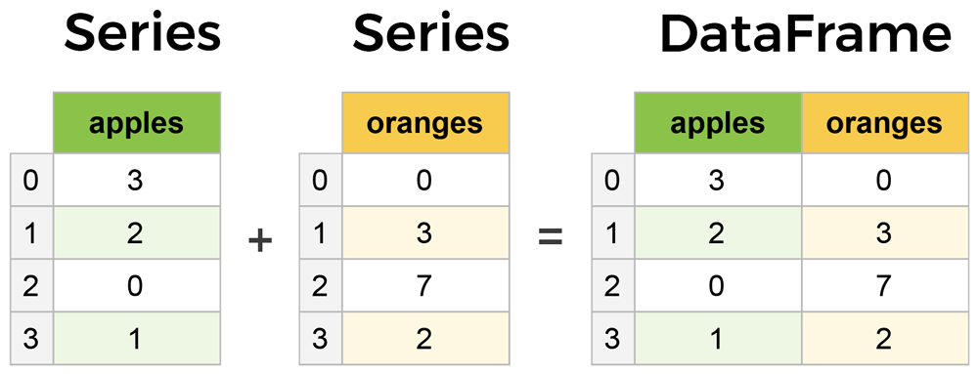
Pandas Data Structure
Pandas has two main data structures. Series and DataFrame.
A Series is essentially a column.
A DataFrame is a multidimensional table made up of a collection of Series.
Image source: learndatasci.com/

Slide 8
Pandas Data Structure - Series
Think of Series as a single column in an Excel sheet. You can also think of it as a 1d Numpy array. The only thing that differentiates it from 1d Numpy array is that we can have Index Names.
Series is a one-dimensional labeled array capable of holding any data type (integers, strings, floating point numbers, Python objects, etc.). The axis labels are collectively referred to as the index.
The basic syntax to create a pandas Series is:
Syntax:
Here, data can be many different things:
a Python dict
an ndarray
newSeries = pd.Series(data,index)

Slide 9
Example: Creating Panda Series from ndarray
If data is an ndarray, index must be the same length as data. If no index is passed, one will be created having values:
[0, ..., len(data) - 1].
Step 1:
import numpy as np
import pandas as pd
s = pd.Series(np.random.randn(5), index=["a", "b", "c", "d", "e"])
s
Step 3:
Output
a -0.924381
b 0.008020
c -0.446630
d 1.407323
e 1.376010
dtype: float64
Step 2:
pd.Series(np.random.randn(5))
s.index
Output
0 -0.116182
1 -0.622787
2 -0.156830
3 -0.906110
4 0.106543
dtype: float64
Output
Index(['a', 'b', 'c', 'd', 'e'], dtype='object')
Notes:
Note” pandas supports non-unique index values. If an operation that does not support duplicate index values is attempted, an exception will be raised at that time.

Slide 10
Hands-on Lab
Please complete the lab GLAB - 343.1.1 - Panda Series, you can find this lab on canvas under assignment section

Slide 11
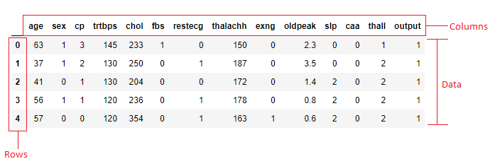
Pandas Data Structure - DataFrame
In Pandas, a DataFrame represents a two-dimensional, heterogenous, tabular data structure with labeled rows and columns (axes). In simple words, it contains three components ― data, rows, columns.
DataFrame is indeed the most commonly used and important data structure of Pandas. Think of a data frame as an excel sheet and nd Numpy array.

Slide 12
Pandas Data Structure - DataFrame (continued)
There are many ways to create a DataFrame from scratch, There are several way to create a pandas DataFrame such as:
Python dictionaries.
Python lists.
Two-dimensional NumPy arrays.
Files.
There are other methods as well, which you can learn about in the official documentation. but a great option is to just use a simple Python dictionaries.

Slide 13
Example: Creating Pandas DataFrame from Dictionary
Let's say we have a fruit stand that sells apples and oranges. We want to have a column for each fruit and a row for each customer purchase. To organize this as a dictionary for pandas, we could do something like:
import pandas as pd
data = { 'apples sales': [3,2,0,1,9,6,3,2,7], 'oranges sales': [0,3,7,2,2,5,8,7,1] }
And then pass it to the pandas DataFrame constructor:
# Convert the dictionary into DataFrame
purchases = pd.DataFrame(data)
purchases
apples sales oranges sales
0 3 0
1 2 3
2 0 7
3 1 2
4 9 2
5 6 5
6 3 8
7 2 7
8 7 1
Result
Each (key, value) item in data corresponds to a column in the resulting DataFrame.
Continue…
Notes:
Each (key, value) item in data corresponds to a column in the resulting DataFrame. The Index of this DataFrame was given to us on creation as the numbers 0-3, but we could also create our own when we initialize the DataFrame

Slide 14
Example: Creating Pandas DataFrame from Dictionary (continued)
The Index of this DataFrame was given to us on creation as the numbers 0-3, but we could also create our own when we initialize the Data Frame. Let's have year names as our index:
purchases = pd.DataFrame(data, index=['2000', '2001', '2002', '2003','2004','2005','2006','2007','2008'])
print(purchases)
Result
apples sales oranges sales
2000 3 0
2001 2 3
2002 0 7
2003 1 2
2004 9 2
2005 6 5
2006 3 8
2007 2 7
2008 7 1

Slide 15
Manipulating with Pandas DataFrame
Consider the previous example. We can find 2002 sales only by using “Datafram.loc” as shown below:
purchases.loc['2002']
Result
apples sales 0
oranges sales 7
Name: 2002, dtype: int64
Pandas DataFrames can sometimes be very large, making it impractical to look at all the rows at once. You can use .head() to show the first few items and .tail() to show the last few items:
purchases.head(n=2)
Result
apples sales oranges sales
2000 3 0
2001 2 3
apples sales oranges sales
2007 2 7
2008 7 1
purchases.tail(n=2)
Result

Slide 16
Hands-On Lab
Please complete the lab GLAB - 343.1.2 - Creating a pandas DataFrame. You can find this lab on Canvas under the Assignment section.

Slide 17
Slice a DataFrame in Pandas
The Pandas DataFrame syntax takes the first set of indexes in the operator for row slicing, and the second set for column slicing. Here is the general rule:
dataframe.loc[row slicing, column slicing]
or
dataframe.iloc[startrow:endrow, startcolumn:endcolumn]
When data is indexed using labels or integers, the best approach is typically to use the dataframe.loc method. When data is indexed/positioned using integers only, the best approach is typically to use the dataframe.iloc function.
Reference: https://pandas.pydata.org/docs/user_guide/indexing.html
Notes:
loc[] is used with column labels/names
iloc[] is used with column index/position.

Slide 18
Hands-On Activity
Please complete the lab GLAB - 343.2.1 - Slicing Pandas DataFrame’s Data. You can find this lab on Canvas under the Assignment section.

Slide 19
Adding New Column to Existing DataFrame in Pandas
There are multiple ways we can add a new column to an existing DataFrame:
Use a dictionary and declare a new list as a column .
Use the DataFrame.insert() method:
insert() method inserts a new column in a specific position or index.
Use the Dataframe.assign() method:
assign() method inserts multiple new columns in a DataFrame, when you need to ignore the index of the column to be added or when you need to overwrite the values of an existing column.

Slide 20
Hands-On Activity
Complete the lab Guided LAB - 343.1.3 - Adding new column to existing DataFrame in Pandas.

Slide 21
Sorting a Pandas DataFrame
You can sort a pandas DataFrame with .sort_values(). This example sorts your DataFrame by the values in the column score 1. The parameter by sets the label of the row or column to sort by. ascending specifies whether you want to sort in ascending (True) or descending (False) order, the latter being the default setting. You can pass axis to choose if you want to sort rows (axis=0) or columns (axis=1).
import pandas as pd
# Define a dictionary containing Students data
data = {'Name': ['Jane', 'Princi', 'James', 'Fadi'],
'Height': [5.1, 6.2, 5.1, 5.2],
'Qualification': ['Msc', 'MA', 'Msc', 'Msc'],
'Score 1' : [56,86,77,45],
'Score 2' : [50,96,60,30]}
print("------before -------")
# Convert the dictionary into DataFrame
df = pd.DataFrame(data)
print(df)
print("------after adding column -------")
# using DataFrame.assign() method adding 'Address' column and equating it to the list
df = df.assign(address = ['NYC', 'NJ', 'CA', 'PA'])
print(df)
print("------after sorting -------")
print(df.sort_values(by='Score 1', ascending=False))
------before -------
Name Height Qualification Score 1 Score 2
0 Jane 5.1 Msc 56 50
1 Princi 6.2 MA 86 96
2 James 5.1 Msc 77 60
3 Fadi 5.2 Msc 45 30
------after adding column -------
Name Height Qualification Score 1 Score 2 address
0 Jane 5.1 Msc 56 50 NYC
1 Princi 6.2 MA 86 96 NJ
2 James 5.1 Msc 77 60 CA
3 Fadi 5.2 Msc 45 30 PA
------after sorting -------
Name Height Qualification Score 1 Score 2 address
1 Princi 6.2 MA 86 96 NJ
2 James 5.1 Msc 77 60 CA
0 Jane 5.1 Msc 56 50 NYC
3 Fadi 5.2 Msc 45 30 PA

Slide 22
Sorting a Pandas DataFrame (continued)
If you want to sort by multiple columns, then just pass lists as arguments for by and ascending as shown below.
# sorting
import pandas as pd
# Define a dictionary containing Students data
data = {'Name': ['Jane', 'Princi', 'James', 'Fadi'],
'Height': [5.1, 6.2, 5.1, 5.2],
'Qualification': ['Msc', 'MA', 'Msc', 'Msc'],
'Score 1' : [56,86,77,45],
'Score 2' : [50,96,60,30]}
print("------before -------")
# Convert the dictionary into DataFrame
df = pd.DataFrame(data)
print(df)
print("------after adding column -------")
# using DataFrame.assign() method adding 'Address' column and equating it to the list
df = df.assign(address = ['NYC', 'NJ', 'CA', 'PA'])
# Observe the result
print(df)
print("------after sorting -------")
print(df.sort_values(by='Score 1', ascending=False))
print (df.sort_values(by=['Score 1', 'Height'], ascending=[False, True]))

Slide 23
Filtering Data from Dataframe
Data filtering is another powerful feature of pandas. It works similarly to indexing with Boolean arrays in NumPy.
data = {'Name': ['Jane', 'Princi', 'James', 'Fadi'],
'Height': [5.1, 6.2, 5.1, 5.2],
'Qualification': ['Msc', 'MA', 'Msc', 'Msc'],
'Score 1' : [56,86,77,45],
'Score 2' : [50,96,60,30]}
# Convert the dictionary into DataFrame
df = pd.DataFrame(data)
print(df[df['Score 1'] > 70])
Example:
Name Height Qualification Score 1 Score 2
1 Princi 6.2 MA 86 96
2 James 5.1 Msc 77 60
Result
Notes:
https://pandas.pydata.org/docs/reference/api/pandas.DataFrame.filter.html

Slide 24
Filtering Data from Dataframe (continued)
You can create very powerful and sophisticated expressions by combining logical operations with the following operators:
NOT (~)
AND (&)
OR (|)
XOR (^)
For example, you can get a DataFrame with the candidates whose:
Score 1 is greater than or equal to 70.
Score 2 is are greater than or equal to 80.
data = {'Name': ['Jane', 'Princi', 'James', 'Fadi'],
'Height': [5.1, 6.2, 5.1, 5.2],
'Qualification': ['Msc', 'MA', 'Msc', 'Msc'],
'Score 1' : [56,86,77,45],
'Score 2' : [50,96,60,30]}
# Convert the dictionary into DataFrame
df = pd.DataFrame(data)
print(df[(df['Score 1'] >= 70) & (df['Score 2'] >= 80)])
Result
Name Height Qualification Score 1 Score 2
1 Princi 6.2 MA 86 96

Slide 25
Determining Data Statistics
Pandas provides many statistical methods for DataFrames. You can get basic statistics for the numerical columns of a Pandas DataFrame with .describe().
data = {'Name': ['Jane', 'Princi', 'James', 'Fadi'],
'Height': [5.1, 6.2, 5.1, 5.2],
'Qualification': ['Msc', 'MA', 'Msc', 'Msc'],
'Score 1' : [56,86,77,45],
'Score 2' : [50,96,60,30]}
# Convert the dictionary into DataFrame
df = pd.DataFrame(data)
df.describe()
Result
Height | Score 1 | Score 2
count | 4.000000 | 4.000000 | 4.00000
mean | 5.400000 | 66.000000 | 59.00000
std | 0.535413 | 18.814888 | 27.64055
min | 5.100000 | 45.000000 | 30.00000
25% | 5.100000 | 53.250000 | 45.00000
50% | 5.150000 | 66.500000 | 55.00000
75% | 5.450000 | 79.250000 | 69.00000
max | 6.200000 | 86.000000 | 96.00000
Here, .describe() returns a new DataFrame with the number of rows indicated by count, as well as the mean, standard deviation, minimum, maximum, and quartiles of the columns.

Slide 26
Handling Missing Data
Missing data is very common in data science and machine learning. But Pandas has very powerful features for working with missing data.
Pandas usually represents missing data with NaN (not a number) values. In Python, you can get NaN with float('nan'), math.nan, or numpy.nan.
Reference: https://pandas.pydata.org/pandas-docs/stable/user_guide/missing_data.html
Complete the lab GLab 343.3.1 - Handling Missing Data. You can find this lab on Canvas.

Slide 27
Read CSV into Panda DataFrame
To read a CSV file with comma delimiter, use df.read_csv(). To read tab delimiter (\t) file, use read_table(). Besides these, you can also use pipe or any custom separator file.
Following is the Syntax of read_csv() function.
# Syntax of read_csv()
pandas.read_csv(filepath, delimiter=None, header='infer', index_col=None, usecols=None, prefix=NoDefault.no_default, dtype=None, skipinitialspace=False, skiprows=None, skipfooter=0, nrows=None, na_values=None, keep_default_na=True, na_filter=True, verbose=False, skip_blank_lines=True, parse_dates=None, infer_datetime_format=False, keep_date_col=False, date_parser=None, dayfirst=False, iterator=False, chunksize=None, decimal='.', lineterminator=None, quotechar='"', quoting=0, doublequote=True, escapechar=None, delim_whitespace=False, low_memory=True)

Slide 28
Example: Reading Data from CSVs Using Pandas
Click here to Download purchase.csv file
df = pd.read_csv('C:\\foldername\\purchases.csv')
df
CSVs do not have indexes like DataFrames do; so, all we need to do is designate the index_col when reading:
df = pd.read_csv('C:\\foldername\\purchases.csv',index_col=0)
df

Slide 29
Hands-On Lab
Please complete the lab GLAB - 343.3.2 - Read CSV into Panda DataFrame. You can find this lab on Canvas under the Assignment section.

Slide 30
Reading Data From JSON Using Pandas Dataframe
JSON file is essentially a stored data in the form of a Python dictionary.
Pandas read_json() method can be used to read a JSON file or string into DataFrame. It supports JSON in several formats by using orient param.
Syntax: pandas.read_json()
Following is the syntax of the read_json() function. This either returns a DataFrame or Series. Use typ param to specify the return type; by default, it returns DataFrame.
pandas.read_json(path=None, typ='frame', dtype=None,convert_dates=True, keep_default_dates=True, numpy=False, date_unit=None, encoding=None, encoding_errors='strict', lines=False, compression='infer', nrows=None)
When you are dealing with huge files, some of these params help you in loading JSON files faster.
Notes:
JSON is shorthand for JavaScript Object Notation which is the most used file format that is used to exchange data between two systems or web applications. When we are working with files in big data or machine learning we are often required to process JSON files.

Slide 31
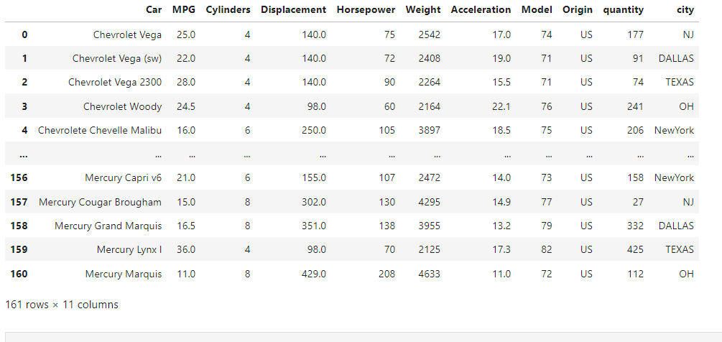
Example: Reading Data From JSON Using Pandas Dataframe
Click here to Download cars.json file
df = pd.read_json('C:/Folderpath/cars.json')
df

Slide 32
Write DataFrame to CSV
By using the pandas.to_csv() method, you can write/save a pandas DataFrame to CSV File. By default, the to_csv() method saves/writes the DataFrame to a CSV file with comma delimiter, and with a column header and row index. You can change this behavior by supplying param to the method. to_csv() takes multiple optional params as shown in the below syntax.
Following is the Syntax of to_csv() function:
# to_csv() Syntax
DataFrame.to_csv(FileName, sep=',' float_format=None,
columns=None, header=True, index=True, index_label=None, mode='w', encoding=None,
compression='infer', quoting=None, quotechar='"', line_terminator=None,
date_format=None, doublequote=True, escapechar=None, decimal='.', errors='strict', storage_options=None)

Slide 33
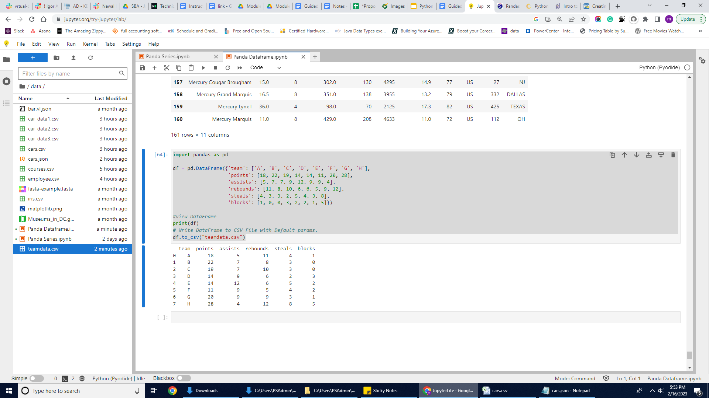
Example: Write DataFrame data to CSV file
import pandas as pd
df = pd.DataFrame({'team': ['A', 'B', 'C', 'D', 'E', 'F', 'G', 'H'],
'points': [18, 22, 19, 14, 14, 11, 20, 28],
'assists': [5, 7, 7, 9, 12, 9, 9, 4],
'rebounds': [11, 8, 10, 6, 6, 5, 9, 12],
'steals': [4, 3, 3, 2, 5, 4, 3, 8],
'blocks': [1, 0, 0, 3, 2, 2, 1, 5]})
#view DataFrame
print(df)
# Write DataFrame to CSV File with Default params.
df.to_csv("teamdata.csv")
Result:
CSV file should be generated, named teamdata.csv

Slide 34
Pandas Aggregate Functions
An aggregate is a function where the values of multiple rows are grouped together to form a single summary value.
Pandas also supports multiple aggregate functions that perform a calculation on a set of values (grouped data) and return a single value.
The most common aggregation functions are a simple average or summation of values. With Pandas 0.20, you may call an aggregation function on one or more columns of a DataFrame.

Slide 35
Pandas Aggregate Functions (continued)
Here are some of the aggregate functions supported by Pandas:
DataFrame.aggregate()
Series.aggregate()
DataFrameGroupBy.aggregate()
AGGREGATE FUNCTIONS | DESCRIPTION
count() | Returns count for each group.
size() | Returns size for each group.
sum() | Returns total sum for each group.
mean() | Returns mean for each group. Same as average().
average() | Returns average for each group. Same as mean().
describe() | Returns different statistics.
min() | Returns minimum value for each group.
max() | Returns maximum value for each group.
first() | Returns first value for each group.
last() | Returns last value for each group.
nth() | Returns nth value for each group.

Slide 36
Python Pandas - GroupBy
Any GroupBy operation involves one of the following operations on the original object, including:
Splitting the object.
Applying a function.
Combining the results.
In many situations, we split the data into sets and we apply some functionality on each subset. In the apply functionality, we can perform the following operations:
Aggregation − computing a summary statistic.
Transformation − perform some group-specific operation.
Filtration − discarding the data with some condition.

Slide 37
Hands-On Guided Lab
Please complete the lab GLAB - 343.3.3 - Pandas Aggregate Functions. You can find this lab on Canvas under the Assignment section.

Slide 38
Hands-On Activities
Please follow the link below for Python Dictionary practices. Open following link on Google Colaboratory.
ACT - 343.1.1 Pandas Series Exercises.ipynb
ACT - 343.1.2 - Pandas DataFrame Exercises.ipynb

Slide 39
Knowledge Check
Define Pandas.
Define DataFrame in Pandas.
Describe the different ways a DataFrame can be created in Pandas.
How can you add a column to a Pandas Dataframe?
How can you add a new column in the third position of an existing dataframe?

Slide 40
Summary
Pandas is an data analysis module for the Python programming language. It is open-source.
A Pandas Series is like a column in a table.
It is a one-dimensional array holding data of any type.
A Pandas DataFrame is a 2 dimensional data structure, like a 2 dimensional array, or a table with rows and columns.

